Slide 1
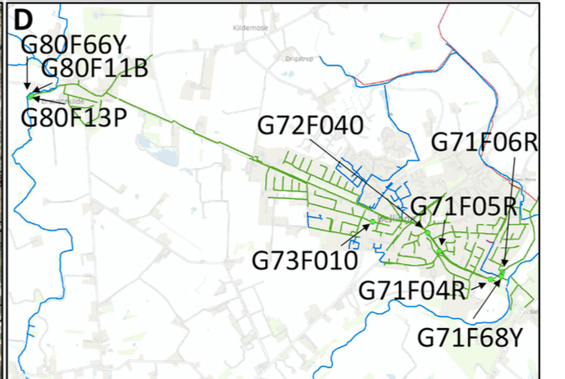
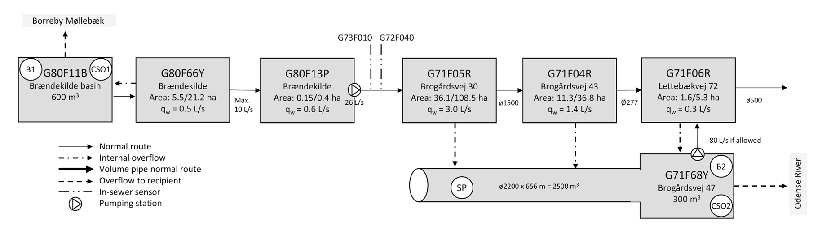
Raingauges
Brændekilde

Slide 2
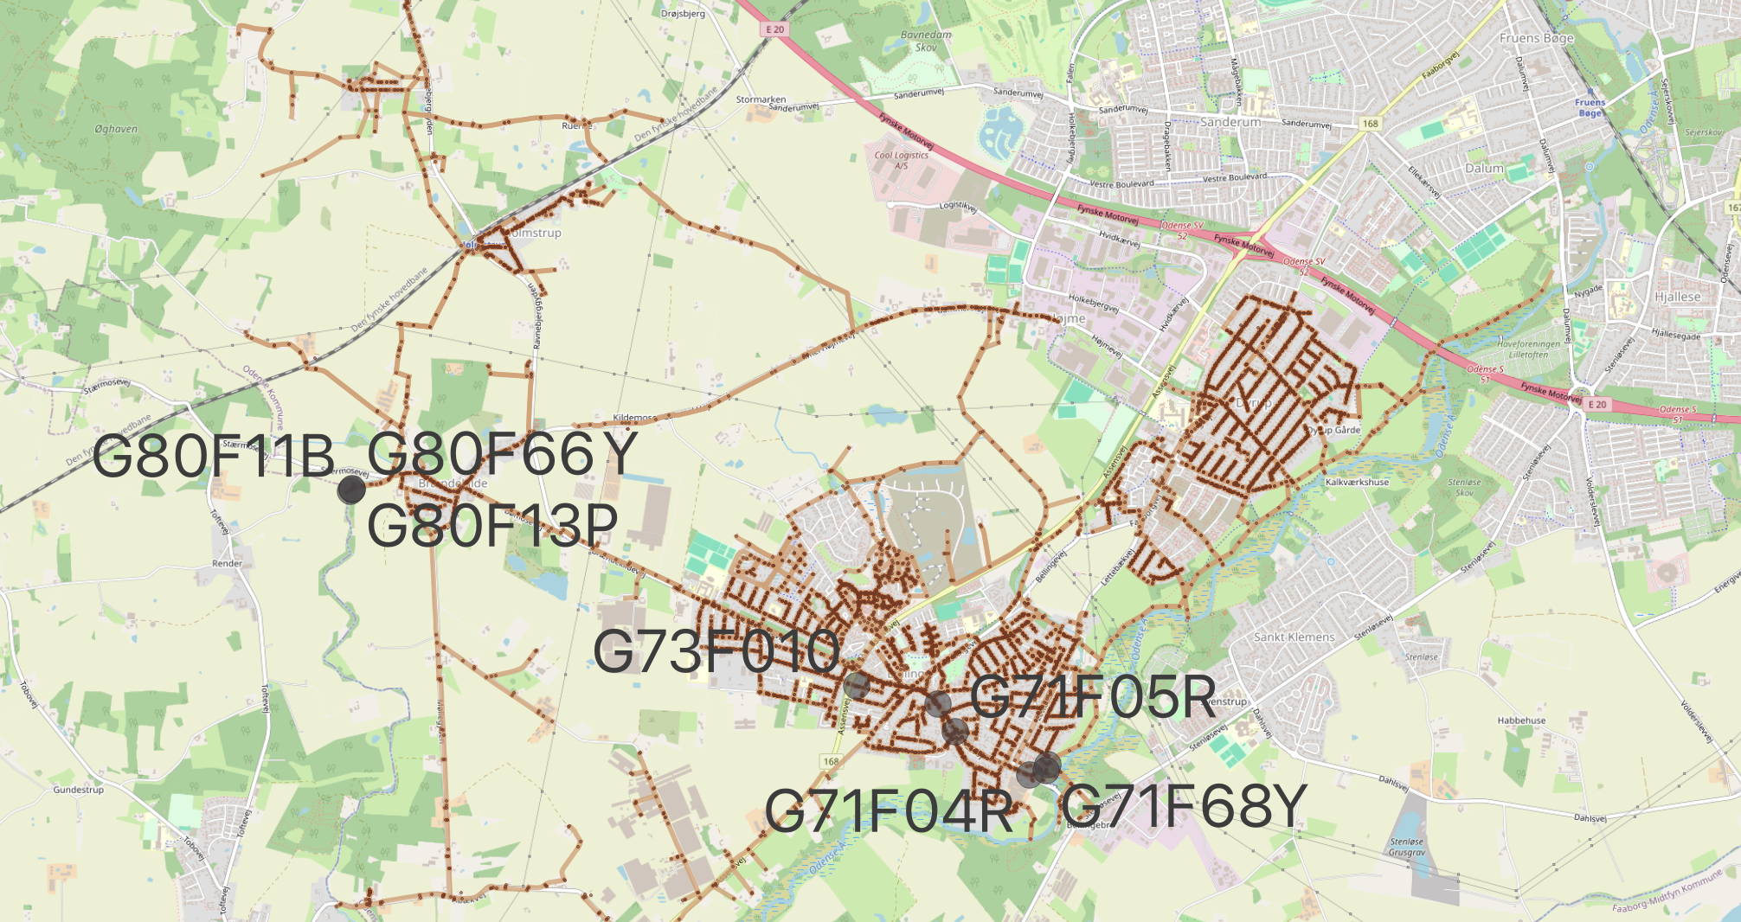
Brændekilde
G80F11B
G80F66Y
G80F13P
Dyrup
5427
Brændekilde
G72F040
G73F010
5425
Bellinge
Bellinge
G71F05R
G71F04R
G71F06R
G71F68Y

Slide 3


Cross-sectional view
Structure 2
Inlet Level
Basin Level
Overflow
Pump Sump
Level
Structure 1
Pipe
Position
Pipe
Level
Flow
Sensors
Power

Slide 4
root
single_series
combined_data
sewer_data
rain_gague_data
raw
clean
G80F11B_Level1
5425
5425
raw
clean
Data
Timestamps
Columns
bools
.
.
.

Slide 5
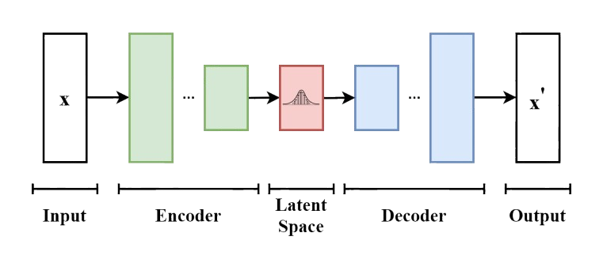
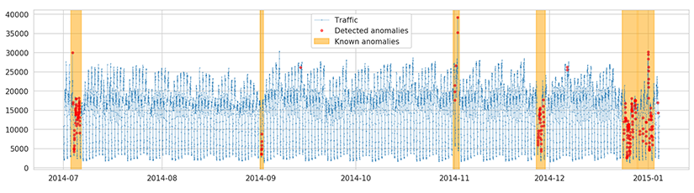
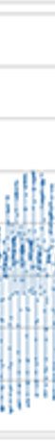
TRAIN
ANOMALIES
MASK
IMPUTE

Slide 6
Diagnostics
Detection
Prognosis

Slide 7
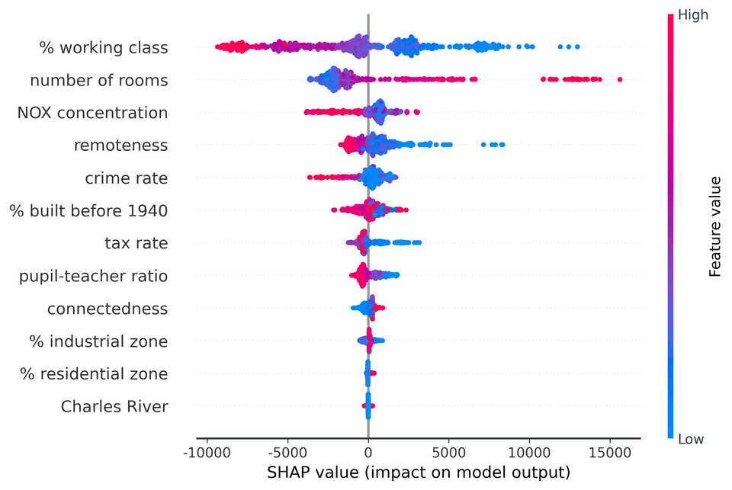
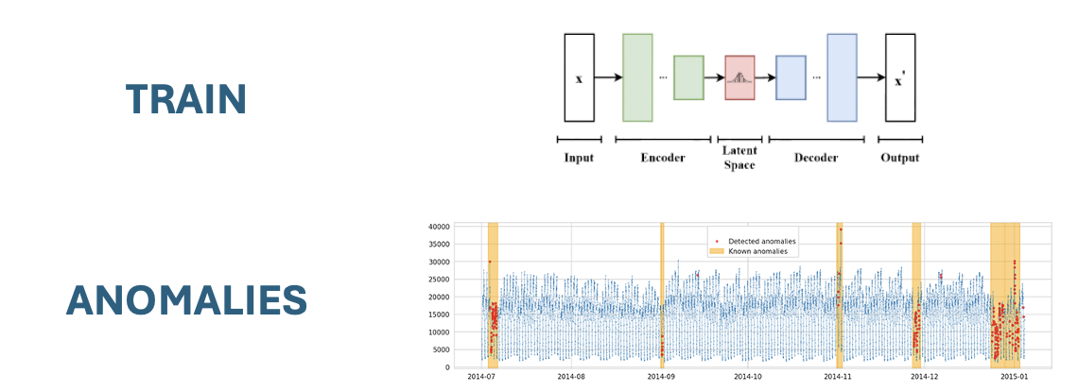
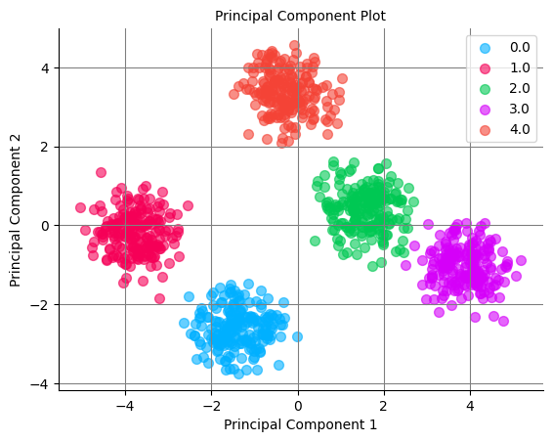
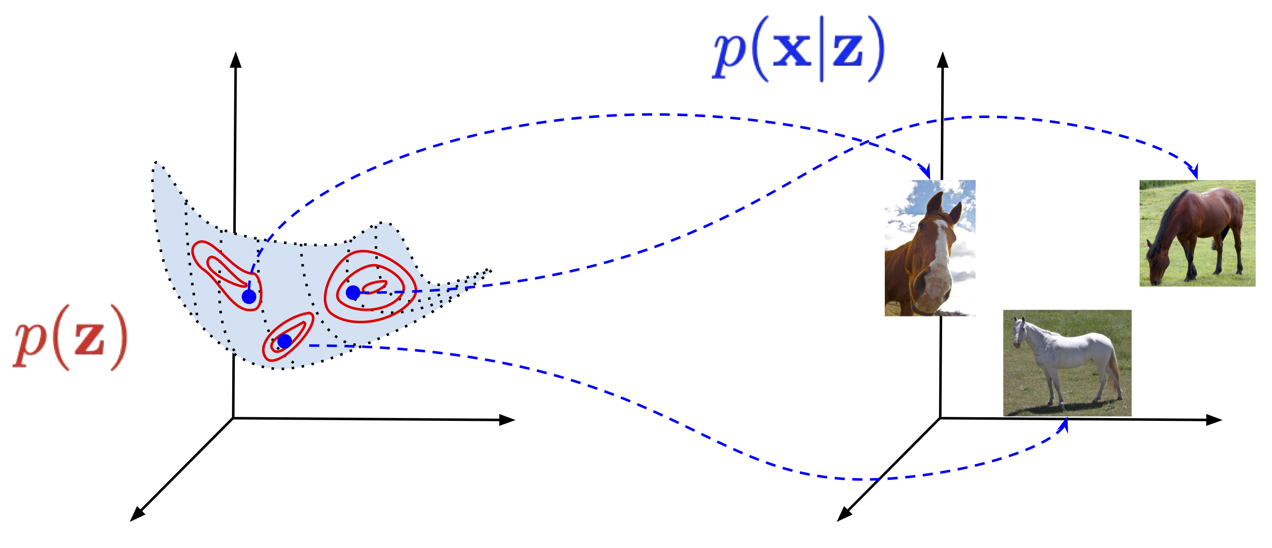
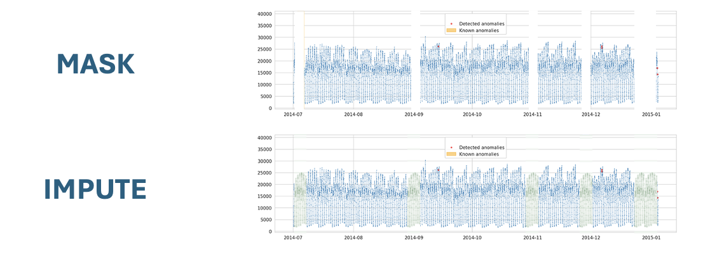
Detect
Diagnose
Prognose

Slide 8
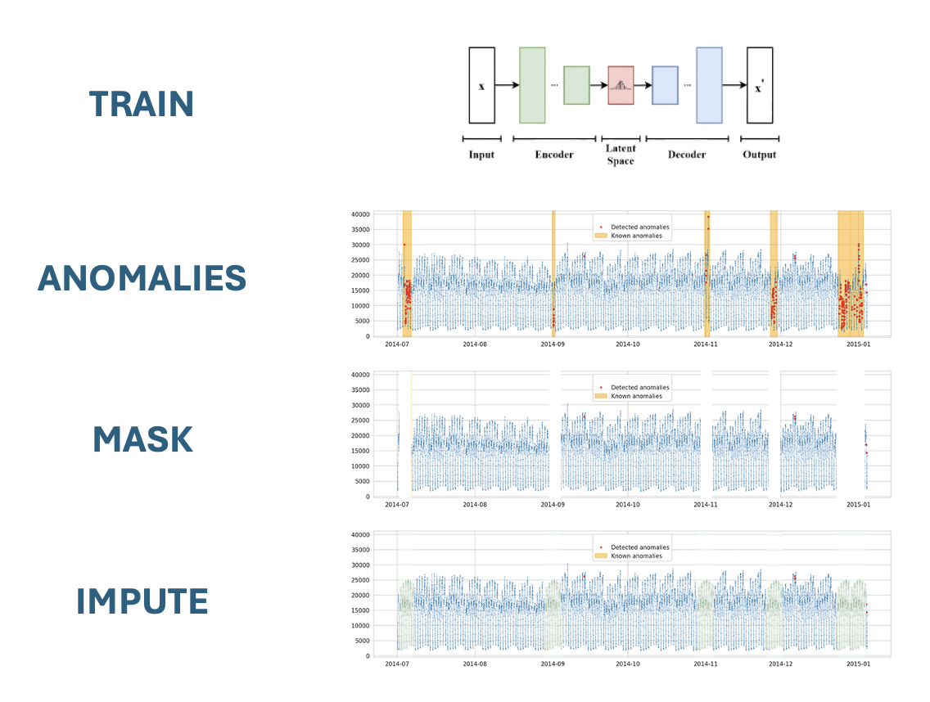


Slide 9
Multiple
SCOPE
Single
Short-term
Long-term
TEMPORAL

Slide 10
Faults
Synthetic
Blockage
Delayed
Blockage
Debris
Corrosion
Step
Response
Step
Drift
Multiple
Multiple
SCOPE
SCOPE
Frozen
Spikes
Noise
Calibration
Baseline shift
Drift
Aging
Frozen
Pulse
Noise
Step
Drift
Response
Single
Single
Short-term
Long-term
Short-term
Long-term
TEMPORAL
TEMPORAL
Notes:
Signal loss?
Pulse?

Slide 11
Origin
Impact
System
Non-critical
Critical
Multiple
SCOPE
Technical
Single
Short-term
Long-term
Short-term
Long-term
TEMPORAL
Notes:
Signal loss?
Pulse?

Slide 12
Definitions
Mutliple sensor faults
Temporal overlap; within 1-2 minutes
And spatial proximity; same structure
Pattern consistency; correlation?
Long term faults
If the errors persists for more than 1 hour
Limitations
We’ll not focus on:
Multiple occurances of the same error within a time frame
Different types of errors occuring within the same time frame
Notes:
How to define

Slide 13
Evaluation
Single sensor Time series detection | Multiple sensors Binary detection | Long term Binary detection
For each error type: Precision & Recall ROC by threshold Binary event detection And combined | Accuracy Confusion matrix | Accuracy Confusion matrix
Notes:
How to define

